Slide 1
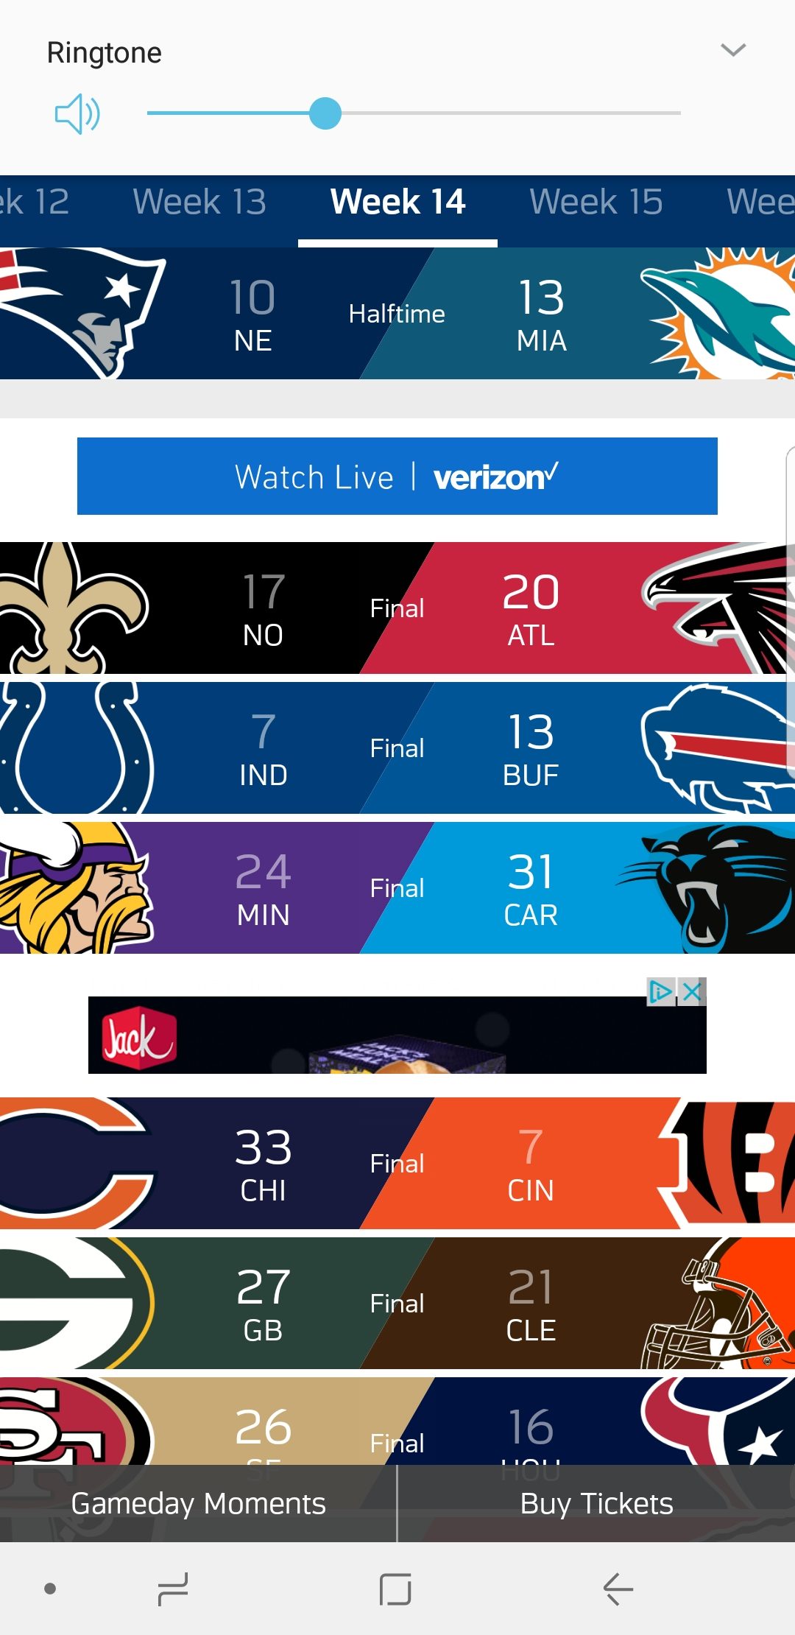

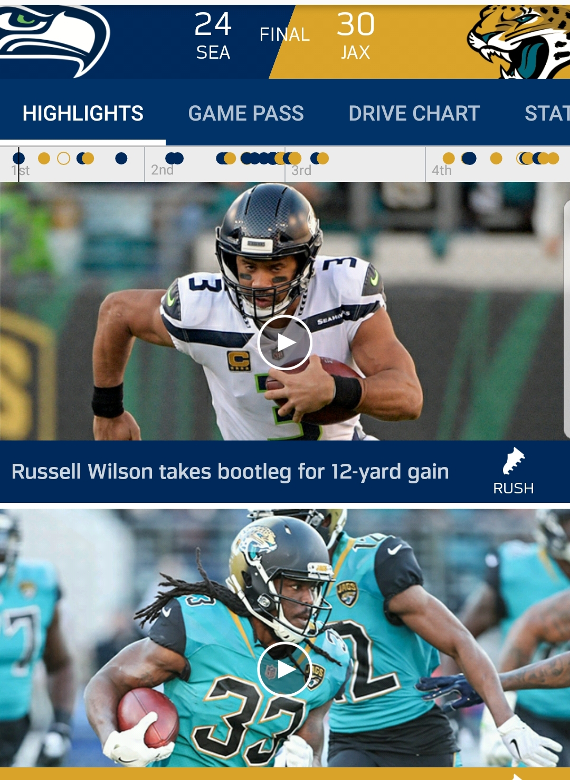

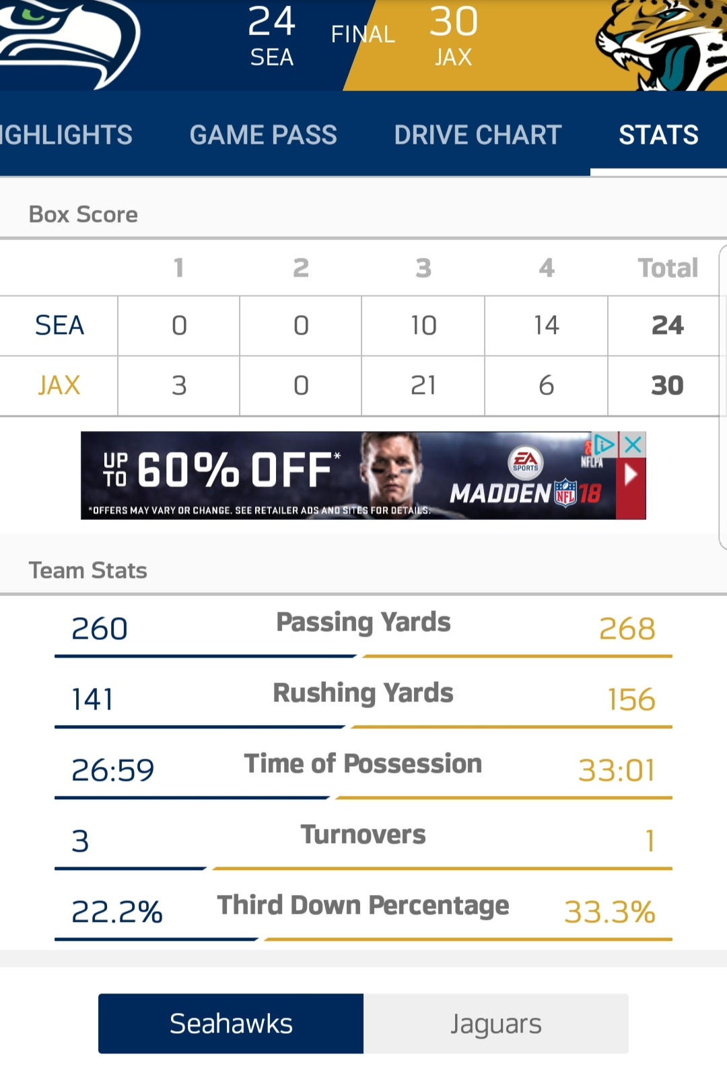
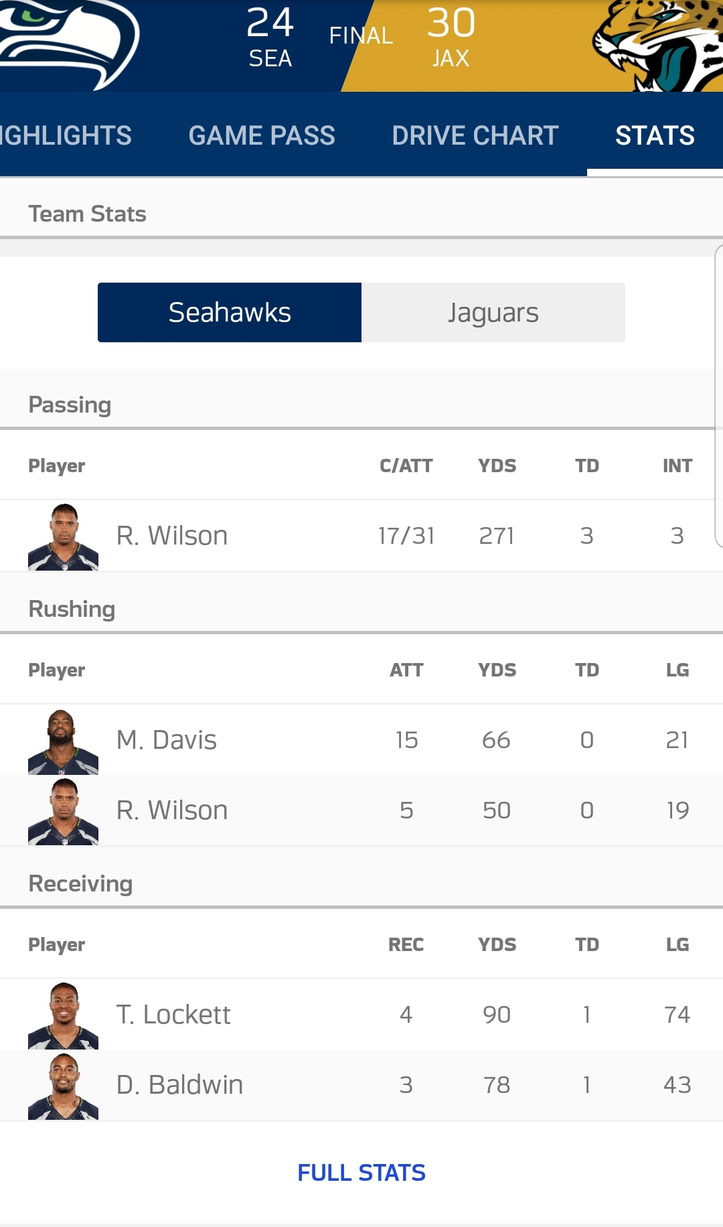
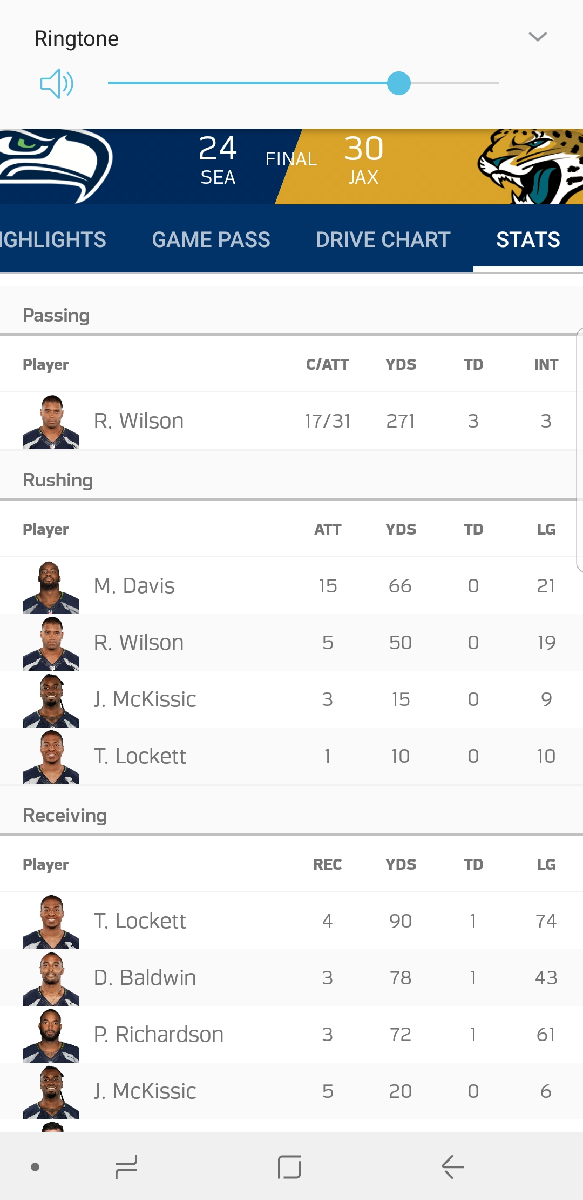
Scroll left and right to find Stats
Scroll Up and Down to find game
Scroll Up and Down to find game clip
Select Stats
Click NFL APP
Select desired game
Scroll down to see player stats
Notice an increase in players
Select “Full Stats” to see every player

